Slide 1
Build AI Bots with Cognitive Services
Share and Learn
March 16th, 2017

Slide 2
Share & Learn Objectives
In this session we will review what is Artificial Intelligence, Machine Learning and Cognitive Computing and look at how Cognitive Computing can be applied to bots
Agenda
A&DM AI/ML Perspective
Why AI/ML and Cognitive Computing is an industry focus?
What are bots and Cognitive Services?
Bot Use Cases and Examples
Takeaways
To share with participants our understanding and practical experiences with building bots

Slide 3
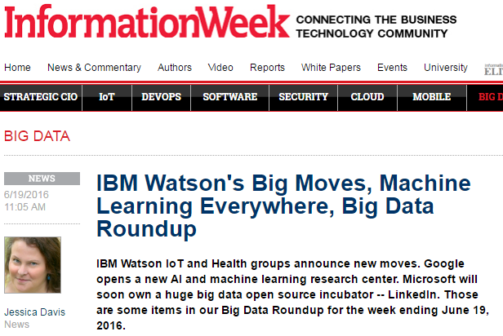
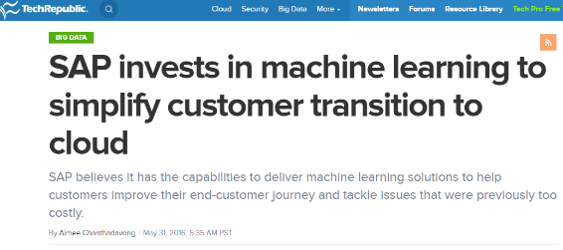
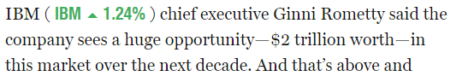
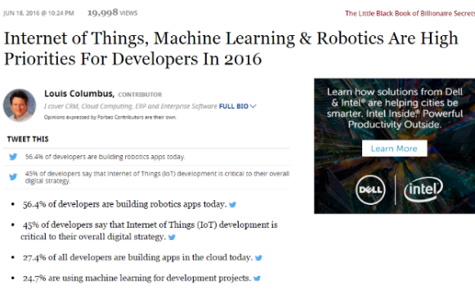
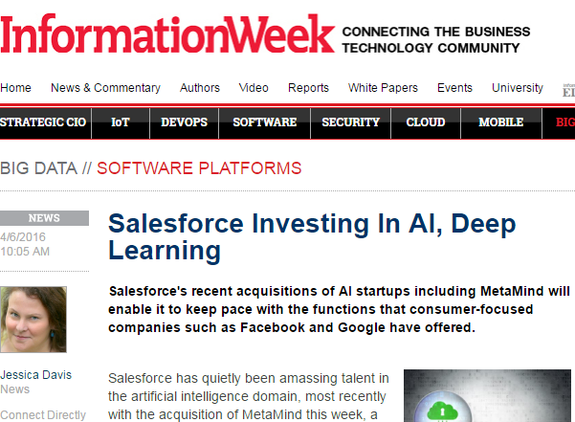
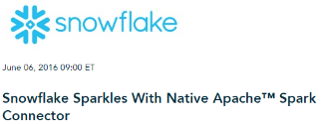
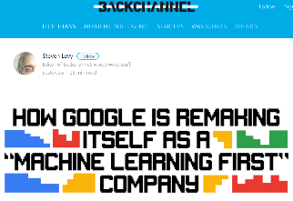
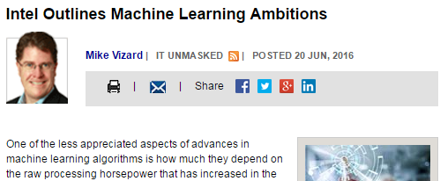
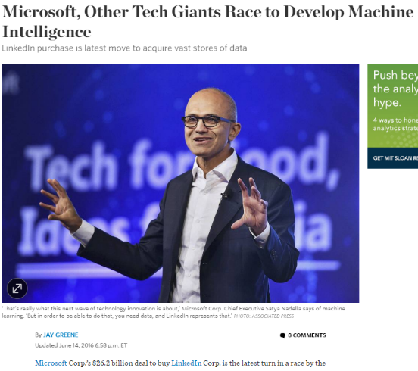
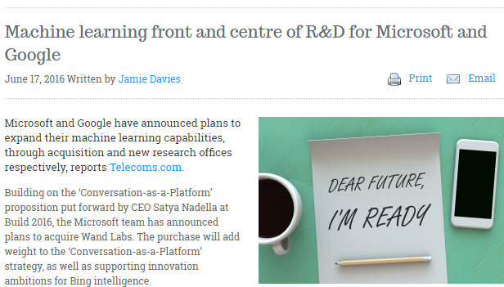
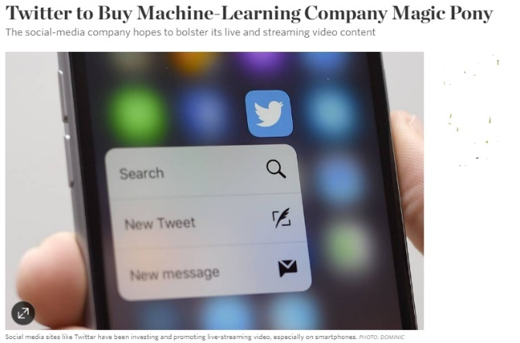
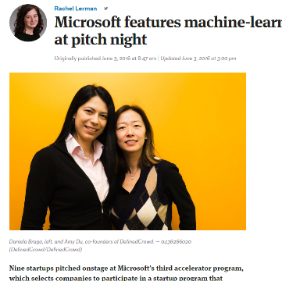

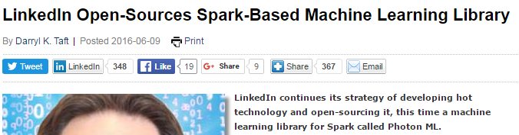
Artificial Intelligence is one of the hottest IT buzzwords
Almost every leading IT company announced some AI-based product
Almost every industry is announcing innovative application for AI-powered technologies
New breakthrough advancements (voice recognition, go, poker)
The bar is raising very fast, and so the definition of what is possible
Every company is puzzling about how to leverage the possibilities offered

Slide 4

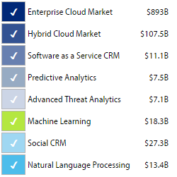
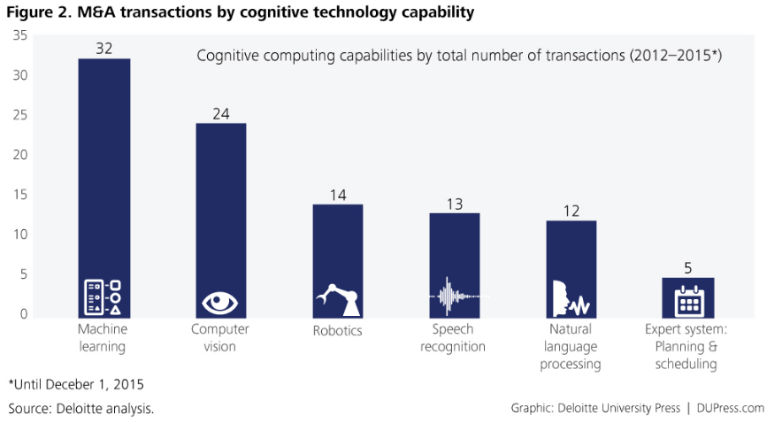

By 2020 50% of all business analytics software will incorporate features built on cognitive computing
2020 Market Estimate

Slide 5
What has changed today?
Until today, the adoption of AI technologies was restricted to a limited set companies, mainly due to:
Required Skills: high investments in Analytical skills to build and train models
Required Data: Huge data sets needed to train models, hard to collect and maintain
Required Platform: High cost and complexity in order to collect, manage, and process big quantities of data
Disruptive factors which enabled the AI wave today:
Cloud, which makes a platform immediately available
Big Data, which enables data processes to scale easily
As a Result, today companies can leverage:
Very powerful analytic tools, with an almost-zero startup delay for prototypes
A large library of trained models, ready to use and embed in application and processes

Slide 6
A&DM AI/ML Perspective

Slide 7
Analytics trends
Analytics sophistication
Artificial intelligence
Talent gaps
Operationalized analytics
Predictive/prescriptive analytics
Graph analytic
Augmented decision-making/automation
Embedded analytics (smart business applications)
Analytics packaged solutions
Machine learning
Robotics
Cognitive computing
Natural language processing
Neural networks
Video and image recognition
Human-computer Interaction
Data scientists
Big data technical expertise
BI and analytics architects and solution engineers
Strategy and advisory expertise
Self-service
IoT
Ecosystem of data
Analytic platforms
Analytics CoE/aaS/Discovery Lab
Self-service data preparation
Self-service data discovery tools (automated algorithm scoring)
Search-based data discovery
Self-service BI (using partner IP)
IoT platforms
Edge computing and analytics
IoT security
Operations optimization
Predictive maintenance
Asset performance management
Mesh computing
GPS/location data
Weather data
Social Media data
Open data
Satellite data
Telemetry data
HPE IP & Portfolio Investment

Slide 8
Artificial Intelligence, Cognitive Computing & Machine Learning
Artificial Intelligence is intelligence exhibited by machines. In computer science, an ideal "intelligent" machine is a flexible rational agent that perceives its environment and takes actions that maximize its chance of success at some goal. AI research include reasoning, knowledge, planning, learning, natural language processing (communication), perception and the ability to move and manipulate objects. (Source Wikipedia) | Artificial Intelligence includes cognitive computing and machine learning, and typically also applies robotics and machines.
Cognitive Computing has been used to refer to new hardware and/or software that mimics the functioning of the human brain and helps to improve human decision-making. IBM has been credited for coining this term and describes it as “systems that learn at scale, reason with purpose and interact with humans naturally.” (Source Wikipedia) | Cognitive Computing include Machine Learning and typically also includes sensing, encoding, processing.
Machine Learning is a method of data analysis that automates analytical model building. Using algorithms that iteratively learn from data, machine learning allows computers to find hidden insights without being explicitly programmed where to look. | Machine Learning focuses on analytics to understand and predict using data.
Artificial Intelligence
Perception
Interaction
Cognitive Computing
Recognition
Memory
Retrieval
Decisioning
Responding
Machine Learning
Supervised Learning
Unsupervised Learning
Reinforcement Learning
Notes:
GARTNER:
http://www.gartner.com/it-glossary/artificial-intelligence/
Artificial intelligence is technology that appears to emulate human performance typically by learning, coming to its own conclusions, appearing to understand complex content, engaging in natural dialogs with people, enhancing human cognitive performance (also known as cognitive computing) or replacing people on execution of nonroutine tasks. Applications include autonomous vehicles, automatic speech recognition and generation and detecting novel concepts and abstractions (useful for detecting potential new risks and aiding humans quickly understand very large bodies of ever changing information)
http://www.gartner.com/it-glossary/machine-learning/
Advanced machine learning algorithms are composed of many technologies (such as deep learning, neural networks and natural-language processing), used in unsupervised and supervised learning, that operate guided by lessons from existing information.

Slide 9
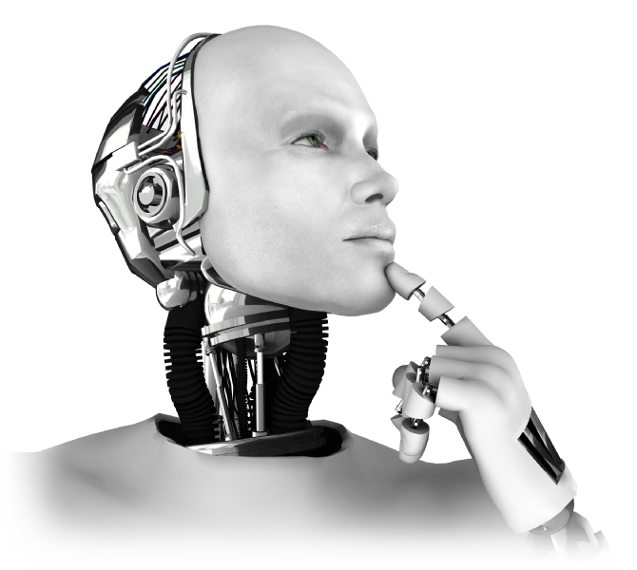
Artificial Intelligence
MEMORY | Long Term Data Storage
 | Short Term Data Cache
RECOGNITION | Image Processing & Recognition
 | Audio Processing & Recognition
 | Text Processing
 | Speech Processing & Recognition
MACHINE LEARNING Machine Learning is the development of algorithms that learn from given data. | Supervised Learning Algorithm is trained using past examples of targeted outcomes
 | Unsupervised Learning Algorithm finds patterns in data with no specific outcome
 | Reinforcement Learning Algorithm learns optimal patterns based on rewards for desired outcomes
PERCEPTION | Seeing Cameras Scanners Digital Images
 | Hearing Microphones Digital Recordings
 | Feeling (Sensors) Temperature Vibration Location Orientation Motion
RETRIEVAL | Search Algorithms
DECISIONING | Rules
 | Optimization
INTERACTION | Robotics
 | Machine Control Systems
RESPONSE | Complex Event Processing
 | Recommendation Engine
 | Natural Language Generation

Slide 10
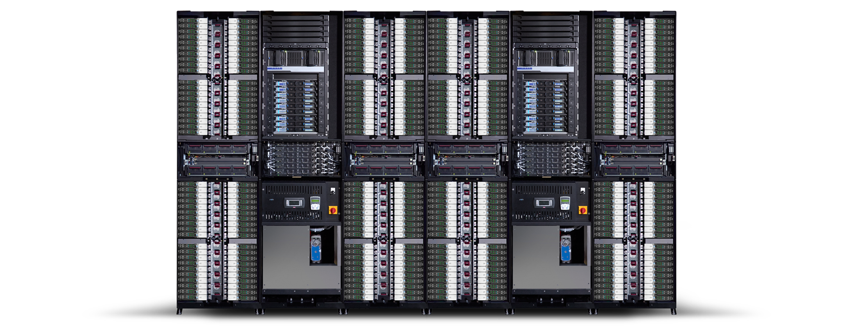
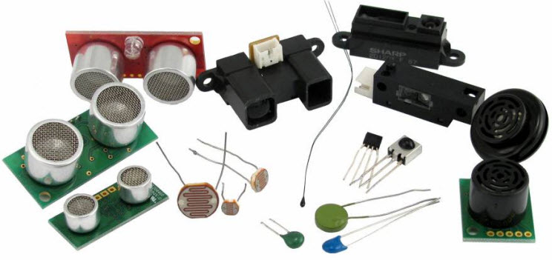
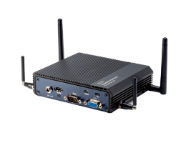
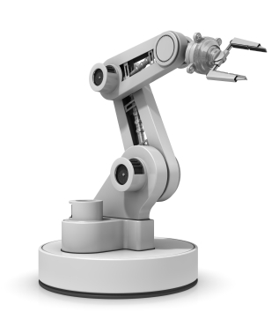

Artificial Intelligence in the Real World
MEMORY | Long Term Data Storage
 | Short Term Data Cache
RECOGNITION | Image Processing & Recognition
 | Audio Processing & Recognition
 | Text Processing
 | Speech Processing & Recognition
MACHINE LEARNING Machine Learning is the development of algorithms that learn from given data. | Supervised Learning Algorithm is trained using past examples of targeted outcomes
 | Unsupervised Learning Algorithm finds patterns in data with no specific outcome
 | Reinforcement Learning Algorithm learns optimal patterns based on rewards for desired outcomes
PERCEPTION | Seeing Cameras Scanners Digital Images
 | Hearing Microphones Digital Recordings
 | Feeling (Sensors) Temperature Vibration Location Orientation Motion
RETRIEVAL | Search Algorithms
DECISIONING | Rules
 | Optimization
INTERACTION | Robotics
 | Machine Control Systems
RESPONSE | Complex Event Processing
 | Recommendation Engine
 | Natural Language Generation

Slide 11
 |  | Domain | Sub-Domain | Function | Common Methods / Techniques
ARTIFICIAL INTELLIGENCE Artificial Intelligence is the famous field of study looking for ways to create machines that are capable of intelligent behavior. |  | PERCEPTION | Sensors | Collect & Stream data
 | COGNITIVE COMPUTING | RECOGNITION Processing is receiving and assessing input. Recognition requires Learning (Below). | Image Processing & Recognition | (See Deep Learning)
 |  |  | Audio Processing & Recognition
 |  |  | Text Processing | Optical Character Recognition (OCR)
 |  |  | Speech Processing & Recognition | Speech to Text
 |  |  |  | Natural Language Processing
 |  | MEMORY | Long Term Data Storage
 |  |  | Short Term Data Cache
 |  | MACHINE LEARNING Machine Learning is the development of algorithms that learn from given data. | Supervised Learning Algorithm is trained using past examples of targeted outcomes | Classification | Decision Trees (C4.5 & CART) Random Forest Logistic Regression Naïve Bayes Classifier Support Vector Machines
 |  |  |  | Regression | Linear Regression Neural Networks
 |  |  |  | Time Series Forecasting | Autoregressive Integrated moving Average (ARIMA)
 |  |  | Unsupervised Learning Algorithm finds patterns in data with no specific outcome | Clustering | K Means Clustering
 |  |  |  | Association Rules | Apriori Algorithm
 |  |  |  | Sequential Pattern Mining | Generalized Sequential Pattern
 |  |  |  | Deep Learning | Multi-layer Neural Network Convolutional Neural Networks Deep Belief Networks
 |  |  | Reinforcement Learning Algorithm learns optimal patterns based on rewards for desired outcomes | Reinforcement Learning | Markov Decision Process
 |  | RETRIEVAL | Search Algorithms
 |  | DECISIONING | Rules
 |  |  | Optimization |  | Simplex
 |  |  |  |  | Gradient Descent
 |  | RESPONDING | Complex Event Processing
 |  |  | Recommendation Engine
 |  |  | Natural Language Generation
 |  | INTERACTION | Robotics | Machine Control Systems
We’ve listed the most common uses and techniques. In reality, different tools can be used in different ways.

Slide 12
HDM Reference Architecture Functions used in AI Bot Solutions
Secure Data
Embed Analytics
Deliver Information
Manage Information
Authentication, Authorization
Complex Event Processing
Business Rules Engine
Analytical APIs and Services
Delivery Channels Interfaces
Master Data, Reference Data, Meta Data Mgmt
Administration, Auditing
Enterprise
Service Bus
Service
Orchestration
BI /OLAP Reports
Search
Visual Analytics
Dash-boards
Records Management, Archive, Info Lifecycle Mgmt (ILM)
Data Encryption
Analyze Data
Analytic Scripts and Models
Data Classification and Quality,
Data Stewardship
Deliver Infrastructure
BI Report and OLAP
Statistical
Methods
Machine
Learning
Rich Media
Analytics
Natural Language
Analytics
Augmented Intelligence
GIS
Analytics
Design & Maintain Solutions
Store, Distribute and Process Data
Data Index
Edge Compute
Hardware, Network
and OS
Design, Development and Testing tools
Data Warehouse, Data Marts/ Cubes, ODS
Analytics Databases
NoSQL Databases
In-memory Compute
Administration and Configuration Mgmt
Data Federation/ Virtualization
File Systems
Extract-Load-Transform
Data Integration
Data Archive,
Backup, Disaster Recovery
Data Management Tools
Monitoring
Provision Data
Software Lifecycle Management
Job Scheduler
Extract-Transform-Load Data Integration
Synchronous Stream Processing
Asynchronous Streams and Batch Ingestion
Data Access services/APIs
Audit, Balance, Control and Lineage
Deliver Service
Development Process and methods
On Premise
Infrastructure as a Service
Platform as a Service
Solution
as a Service
Managed
Notes:
The idea of this slide is to showcase that our RA 2.1 can be used as a starting point for building the AI Bot solutions and that the key functions are used by the use cases discussed later in the presentation. You can add small adjustments if necessary

Slide 13
Our Findings

Slide 14
Bot solutions we reviewed
Type | Vendor | Products | On-Premise / Cloud | Chat Bot | Cognitive APIs | Knowledge Base
Big IT Players | Google | Assistant, Allo | Cloud |  | X
 | Microsoft | Bot Framework | On Premise + Cloud | X | X | X
 | Facebook | Messenger Platform, Wit.ai (open) | Cloud | X | X
 | HPE | HAVEn OnDemand | On Premise + Cloud |  | X | X
Specialized | FlexAnswer |  | On Premise | X
 | Creative Virtual | V-Person, V-Portal | On Premise | X |  | X
 | noHold | VA, SICURA | On Premise | X |  | X
 | Artificial Solutions | Teneo | On Premise | X
 | Nuance | Nina Web | On Premise + Cloud | X |  | X
 | EChatbot |  | Cloud | X
Open | ALICE 2.0 (AIML) |  | On Premise | X
 | SuperBot |  | On Premise | X
Online | Pandorabots (AIML) |  | Cloud | X
 | ChatFuel |  | Cloud | X
 | Reply.ai |  | Cloud | X
 | Imperson |  | Cloud | X
 | Api.ai |  | Cloud | X

Slide 15
Microsoft Cognitive Services Areas Covered
Vision
From faces to feelings, allow your apps to understand images and video
Speech
Hear and speak to your users by filtering noise, identifying speakers, and understanding intent.
Language
Process text and learn how to recognize what users want
Knowledge
Tap into rich knowledge amassed from the web, academia, or your own data
Search
Access billions of web pages, images, videos, and news with the power of Bing APIs
Notes:
What are Cognitive Services? Microsoft Cognitive Services are a new collection of intelligence and knowledge APIs that enable developers to ultimately build smarter apps.
That Microsoft Cognitive Services collection is new, not a rebrand of Project Oxford, as we are bringing together Bing, Oxford and Translator APIs.
That we are bringing together Intelligence (Oxford) and Knowledge from the corpus of the web (Bing)
That cognitive = human perception and understanding, enabling your apps to see the world around them, to hear and talk back with the users—to have a human side.

Slide 16
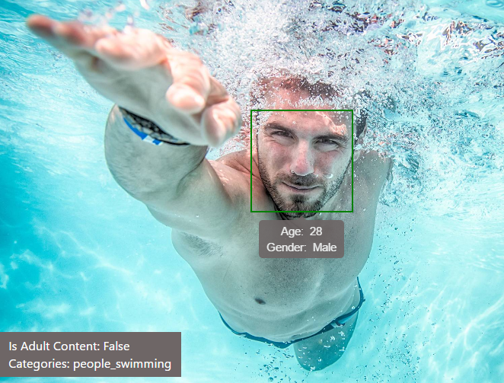

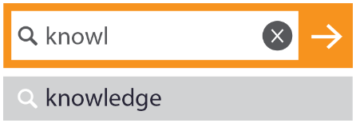
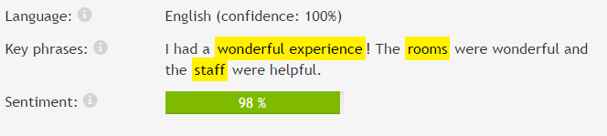
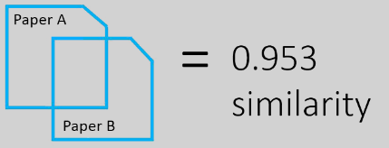
Cognitive Services Examples
Face API
Computer Vision API
Detect, identify, analyze, organize, and tag faces in photos
Distill actionable information from images
CC 4000 1234 5678 9010
Expires 12/14
I had a wonderful experience! The rooms were wonderful and the staff were helpful.
Text Analytics API
Search API
Analyze text, extract sentiment, topics
Provides classification and search

Slide 17

Bot Definition & Key Features
Fully Automated Natural Language Interaction with Humans
Provides easy, organized access to knowledge for real-time customer service and response
Delivers consistent answers and information across teams and departments
Reduces handling times and repetitive questions
Delivers consistent answers, information and brand messaging across channels
Provides 24/7 self-service access to information
Empowers customers with organized, searchable content on the channel of their choice or convenience (including social and mobile)
Automate processes like product subscriptions, account transfers

Slide 18
Bot Solutions have 3 Major Components
Natural Language Processing (NLP) API
Channels Integration API
Bot Application

Slide 19
Finance Use Case: Virtual Assistant Bot
Business Value and Architectural Scenarios

Slide 20

Virtual Assistant
Event Driven Marketing
BANK <-> CUSTOMER INTERACTION
VIRTUAL ASSISTANT
ANALYTICS ENGINE
BANK <-> CUSTOMER INTERACTION
Organizational details (name, customer name, themes)
NLP based entity extraction
Aggregated Transaction History
Customer Profile
Other Financial Indicators
Propose Services
CUSTOMER
BANK
CUSTOMER
Bank employee speaks to client over phone and customer talks about :
“secure monitoring of business accounts…”
“…Treasury needs help with currency positions…”
“…corp card interest rate high with low credit period…”
Bank employee uses Virtual Assistant
Provides call notes on organizational details and summary of conversation
Virtual Assistant does NLP based summarization and entity extraction
Virtual Assistant interfaces with Analytics engine
Analytics engines uses machine learning techniques to do cross-sell and up-sell analysis to suggest product/services
Bank employee proposes the targeted products/services to customer
Business cash flow services
Business card solutions
Financing solutions

Slide 21
Virtual Assistant Architecture
Event Driven Marketing - Basic
Covered
Provide KB product info
Access external Data
Cognitive APIs
Channels
NOT Covered
Customer data is not retained and used for suggestions
Not connected to campaigns
Not connected to bank services
Mobile Application
Bot Interface
External Data (Bloomberg)
Virtual Assistant
Application
Knowledge Base
Web Portal
Call Center
STT
Advisor Metadata
Channel
Virtual Assistant
Internal System
External System

Slide 22
Virtual Assistant Architecture
Event Driven Marketing - Processes Integrated
Covered
Provide KB product info
Provide external data
Enrich customer profile using conversation data
Use customer data to define specific suggestions
Channel for specific campaigns
Triggers Event-Driven Campaigns
Provides other bank services
Competitive Intelligence
External Data (Bloomberg)
Cognitive APIs
Knowledge Base
Channels
Mobile Application
Bot Interface
Single Customer View
Virtual Assistant
Application
Web Portal
Next Best Offer
Analytic Models
Call Center
STT
Campaigns
Advisor Metadata
Speech to Text
Competitive Intelligence
Other Processes (e.g. Inquiry, Support, Sales, Chatbots etc.)
Channel
Virtual Assistant
Internal System
External System

Slide 23
Virtual Assistant
Coverage for long term opportunities
BANK <-> CUSTOMER INTERACTION
BANK EMPLOYEE
ANALYTICS ENGINE
BANK <-> CUSTOMER INTERACTION
Org Details
Call Details
Workflow, Thresholds
Workflow rules
Machine learning alg.
BANK EMPLOYEE
Propose Services
CUSTOMER
BANK
CUSTOMER
Bank employees speak to multiple stakeholders in customer organization
Customer mentions “If market conditions change and interest rates move into xx range, we are thinking of yy..”
“Great. If things change we’ll get back to you”
Makes note of the opportunity using Virtual Assistant technology which records (speech to text or text led)
Organizational details
NLP based notes
Over a period of time, if market changes, Virtual Assistant generates lead
Linked to key data sources
Statistical and client set threshold definition
Workflow engine and trigger rules
ML algorithms for propensity and cross-sell
Bank employee calls client
“…We spoke last quarter and now the market has changed…”

Slide 24

Virtual Assistant Architecture
Coverage for long term opportunities
Covered
Provide KB product info
Provide external data
Enrich customer profile using conversation data
Use customer data to define specific suggestions
Channel for specific campaigns
Triggers Event-Driven Campaigns
Provides other bank services
Competitive Intelligence
External Data (Bloomberg)
Cognitive APIs
Knowledge Base
Channels
Single Customer View
Advisor Portal
Bot Interface
Virtual Assistant
Application
Next Best Offer
Analytic Models
Conversation Listening
STT
Advisor
Campaigns
Advisor Metadata
Competitive Intelligence
Other Processes (e.g. Inquiry, Support, Sales, Chatbots etc)
Channel
Virtual Assistant
Internal System
External System

Slide 25
Banking Demo
Personal Financial Advisor

Slide 26
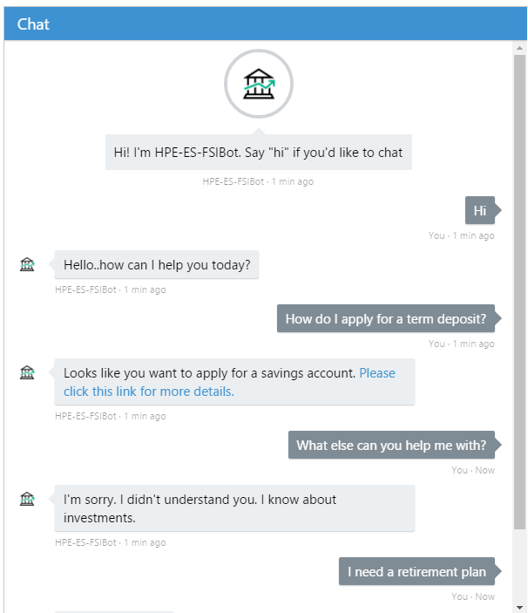
Banking Demo – Personal Financial Advisor
Built using Microsoft Bot Framework
Entirely running in Azure
LUIS – Language Understanding Intelligence Service used for natural language processing
Configured to identify intents and entities. Built by supplying sample utterances and training the model.
In this example understands “enquire” and “apply” intents with entities defined as banking services (various types of cards and accounts).

Slide 27
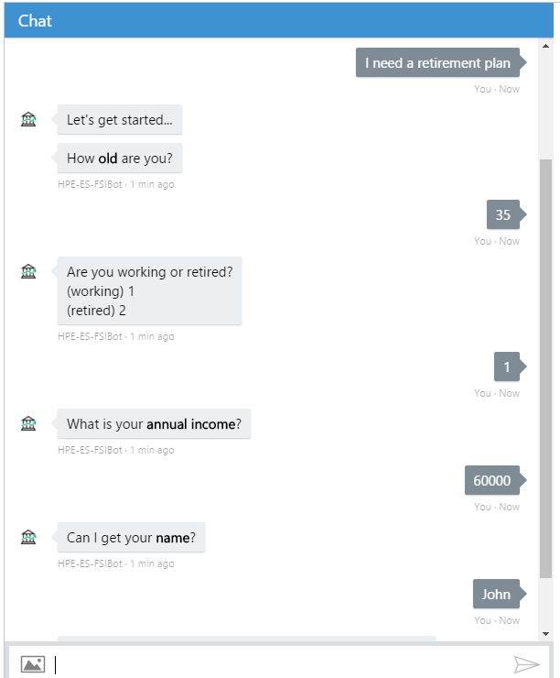
Banking Demo – Personal Financial Advisor
“Financial Advice” intent changes mode to prompt user to fill-in a form
Standard set of questions about investment experience which must be completed before providing financial advice
Implemented using Bot Framework FormFlow API where you define the properties of an object and the bot will then collect the required information
A structured dialogue aimed for completing a form

Slide 28
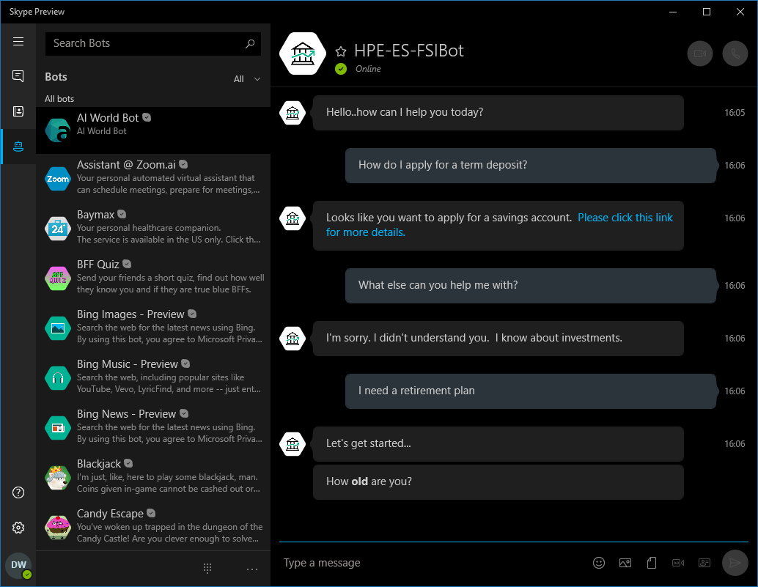
Banking Demo – Personal Financial Advisor
The same bot is accessible via different channels such as:
Facebook Messenger
Skype
Telegram
Microsoft Teams
Slack
…and more

Slide 29
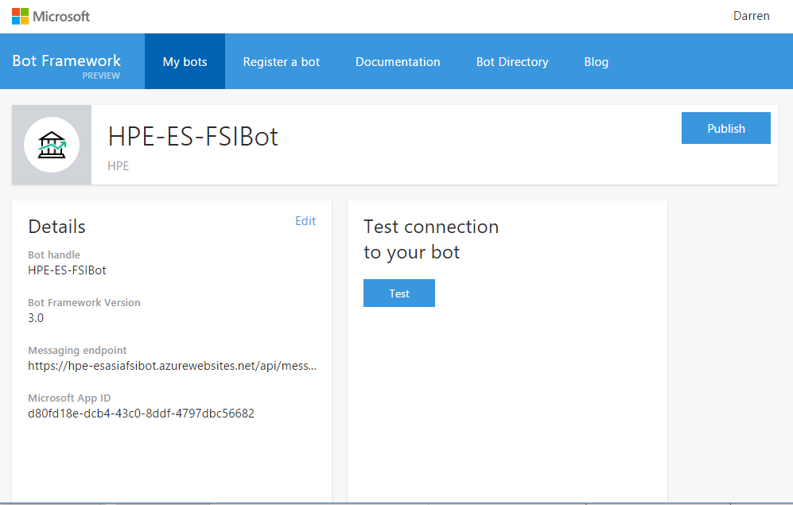
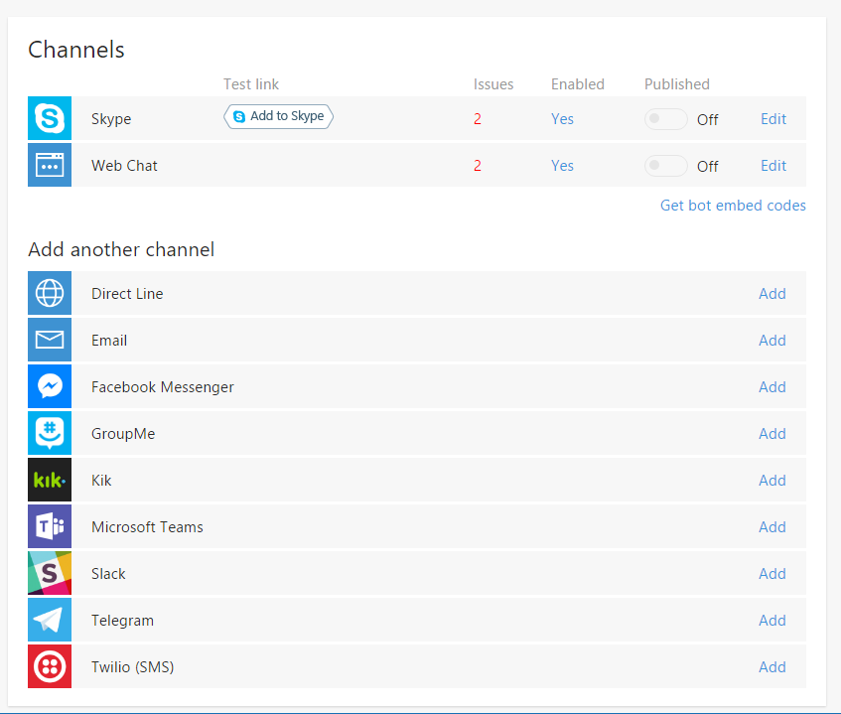
Bot Framework – Registering a Bot

Slide 30
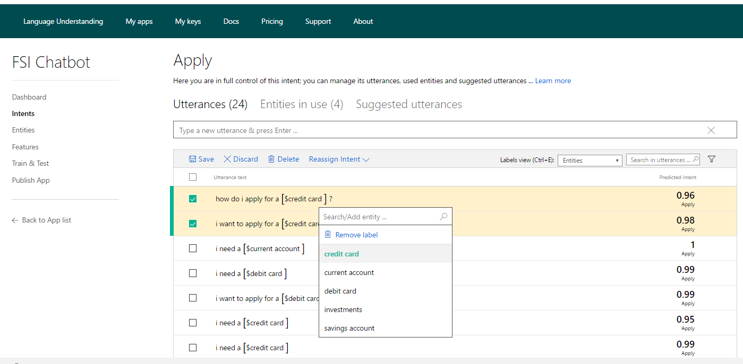
LUIS – Language Understanding Intelligence Service

Slide 31
Knowledge Base Demo
Generating a Bot from a FAQ

Slide 32
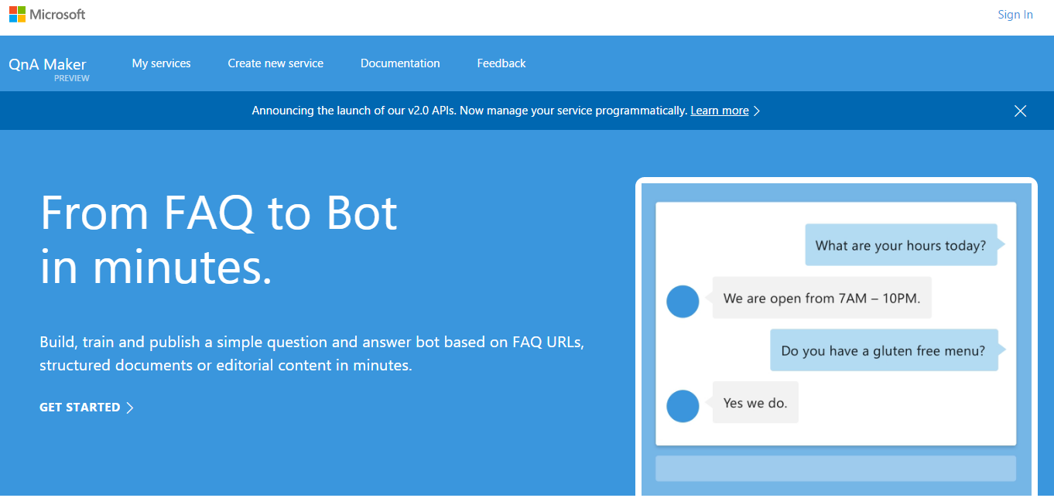
QnA Maker Service

Slide 33
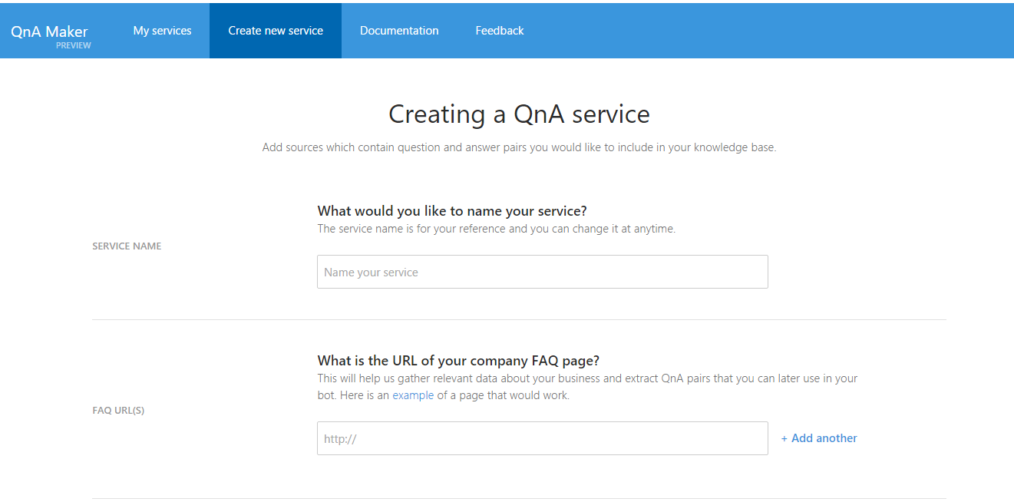
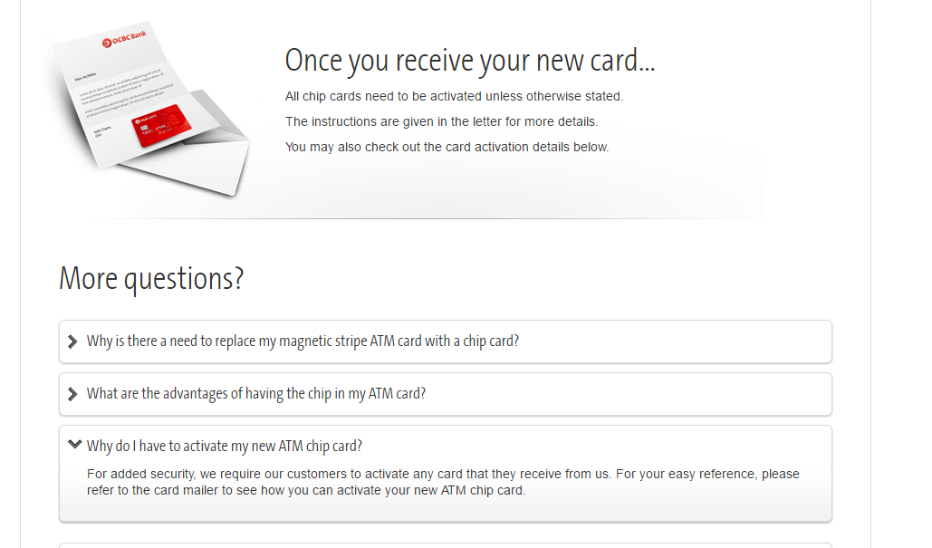
QnA Maker – Create a Service

Slide 34
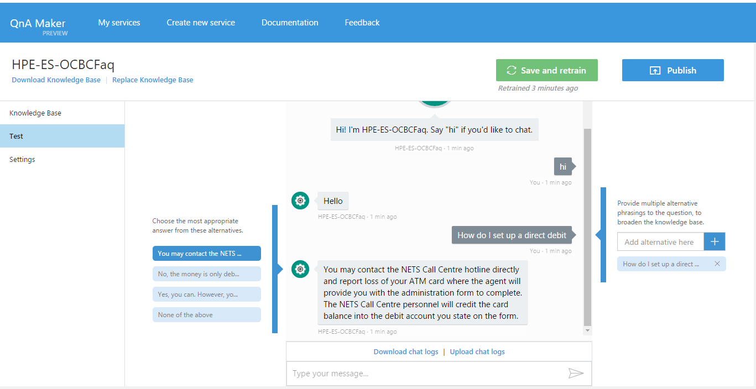
QnA Maker – App Testing and Tuning

Slide 35
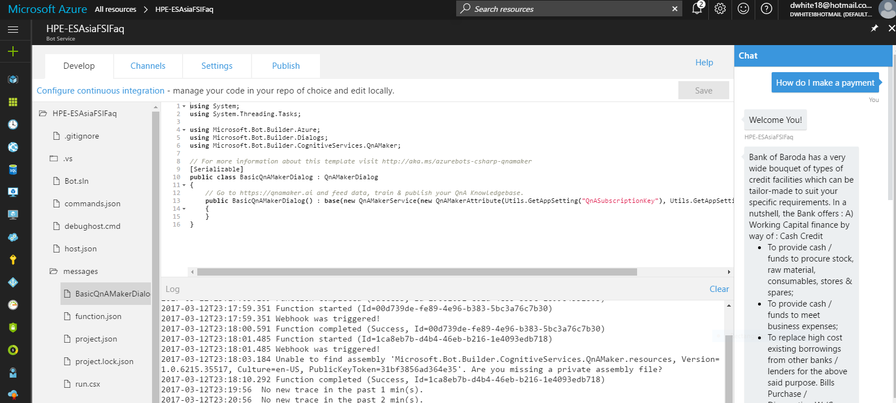
Azure Bot Service - an integrated environment for building & deploying bots

Slide 36
Retail Use Case
Store assistant

Slide 37


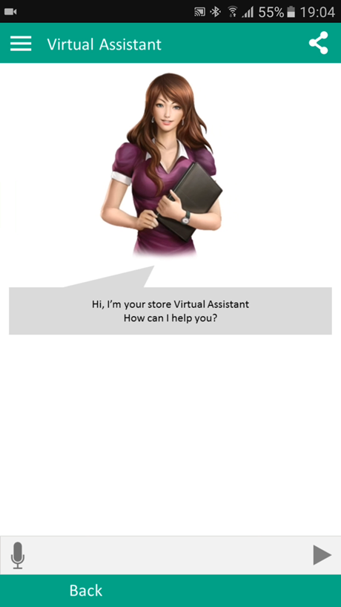
Store Use Case - Virtual Assistant
A Store Virtual Assistant is a flexible tool able to support customers inside a store
Is able to respond to questions in natural language, provide reminders, links and guide through processes like fill a form
Can be used through text-based chats or voice
Doesn’t require a specific App, can be embedded in web pages, social or chat application already used by customers

Slide 38
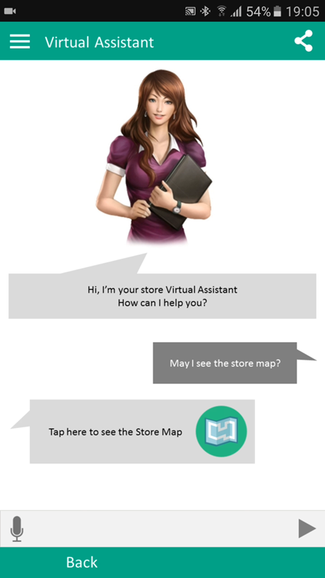
Virtual Assistant
A simple customer question is to provide a store map
The Assistant is able to understand the request and provide a static map
It can also provide a link to the Retailer App, with an Indoor Location and Navigation service

Slide 39

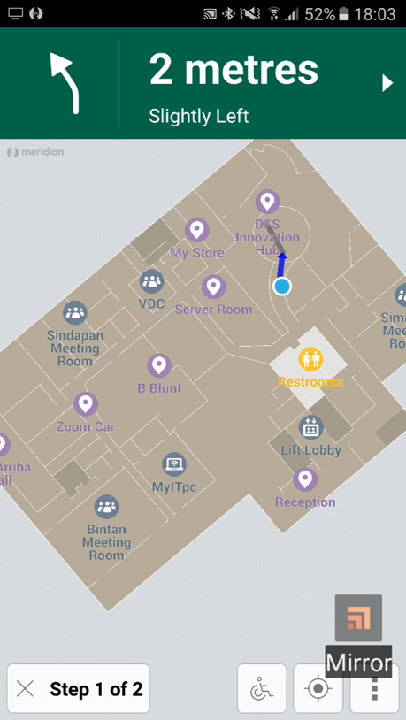
Indoor Location and Navigation
With Meridian, a customer device can show the customer location and guide him to the product is looking for
It can help them to locate specific places like desk or dressing room
Can also provide the opportunity to locate friends and Sales Assistants in the store area

Slide 40
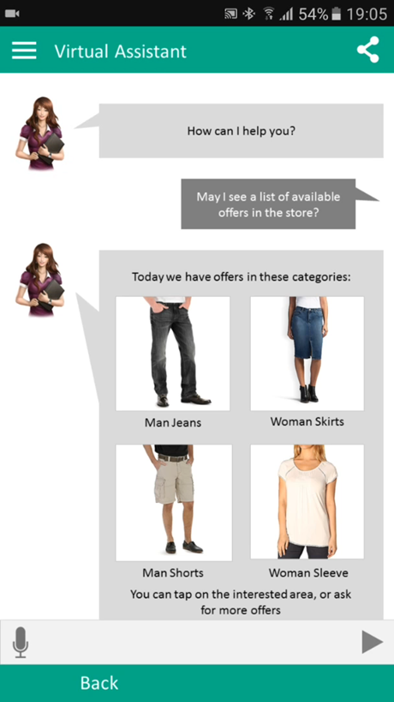
Virtual Assistant
Another example: customer asks about available offers
Without a customer identification the response is generic, but can be refined with further questions or selections
When a customer finds an interesting offer, he can get details and be guided to the specific location

Slide 41
Support Chat Bot
Bank of Baroda PoV

Slide 42
Overview
Customer Need | Bank of Baroda uses Finacle as their core banking system with around 40,000 users. Currently help documentation is available via a self-service “knowledge base” site which contains HTML Help and documents in (Word and PDF) format. The documents are job cards (work instructions) on how to perform specific tasks on Finacle. The job card site is not well organised and it is difficult for users to find the information they are looking for. The bank is looking to provide better support to Finacle users by making it easier to find relevant help documentation. The aim is to increase productivity and reduce number of calls to the helpdesk and related costs.
Solution Proposed | The solution proposed by HPE is to build a Chat Bot agent, an AI-based interface able to guide users through text-based conversations in natural language. The aim of the Bot is to provide fully automated support to users looking for help on how to perform a task on the system using a chat based interaction The output of the conversation would be a specific guide paragraph or a link to the relevant job card (work instruction) page.

Slide 43
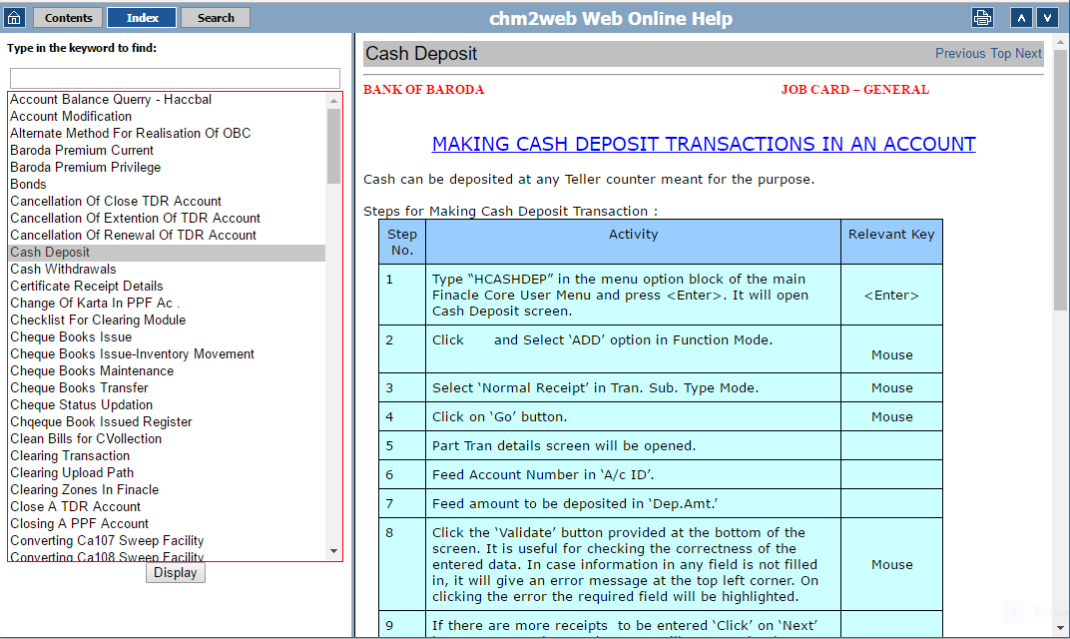
Sample Job Card

Slide 44
Scope of PoV (Proof of Value)
Acquire Finacle KB documents provided by BoB. The exact perimeter will be a subset of the current documentation, defined during the project activity in order to meet the initial PoV 1-month timeline.
Domain of knowledge base is constrained to HTML Help job cards related to core banking system (Finacle). Other systems and documents in other formats (Word and PDF) will be excluded from the PoV.
KB documents are not in Question – Answer format optimal for the chatbot KB access, so the team has to perform a specific classification activity supported by automated classification services available in Azure.
Perform an initial analysis activity to identify specific test cases, including typical conversation structures to cover
Develop a specific Bot application accessible through a web channel, to manage the KB article identification
Run a test session with a group of bank users, which will access the bot service and will provide a feedback about the user experience. The PoV team will analyse the conversations and provide a summary to BoB.

Slide 45
Chat Bot Pilot – PoV Scope and Team
Role | Description
Architect / Platform Specialist | Team leader with specific platform and solution architecture skills
Developer | Developer with specific Node.js or C# skills, focused on

Slide 46
Outcome/ Achievements of PoV
The success factor of the PoV will be defined in relation of the ability to point users to relevant content during the chat conversation
The conversation page will provide a voting function for the users, in order to enable them to provide a satisfaction score at the end of the conversation. That score will be a value between 0 (unsatisfied) and 100 (completely satisfied) to summarize the effectiveness of the conversation.
The user will also be able to leave a text comment to highlight issues or comments related to the conversation
Chat logs and score results will be analysed by the team, summarized and shared with BoB at the end of the activity

Slide 47
Critical Success Factors
We need to know what problems the users are facing.
Source content is not well structured, classified or tagged, so KB conversion can be difficult.
The team needs domain knowledge to help structure the content.
Tool Roadmap (Microsoft QnA Maker) – a new service released as part of Cognitive Services that creates a knowledge base from a FAQ and responds to questions. Currently does not support disambiguation, each question is mapped to an answer.

Slide 48
Next Steps / Proposed Roadmap
Extend KB Perimeter and user base
Articulate Bot conversations trough multiple levels
Integrate human operator routing of conversations
Provide form filling conversations
Connect bank services and applications
Extend number of channels (e.g. instant messaging, portals, mobile, voice etc.)
Provide auto summaries and analytics on conversation content to capture value and optimize process
Generate alerts and notifications for internal users
Inline bots, embedding bot functions into corporate processes and applications

Slide 49
Q&A

Slide 50
Thank you

Slide 51
Typical Virtual Assistant Capabilities
CONVERSATIONAL ABILITIES
Able to handle out of band or uncommon queries and questions
Able to converse and switch to a more secure mode without losing context and flow of conversation
Identity logical end of conversation
NLP AND MACHINE LEARNING
Context sensitiveness
Text processing, opinion mining and sentiment analysis
Named entity recognition and relationship extraction
Topic segmentation and extraction
Self-censorship
Question answering
KNOWLEDGE BASE
Prioritize knowledge base takes precedence for the conversational flow
Select KB to use for each category of user
Read information from external sources
Handle general queries, non-organizational queries, account specific queries
PERSONALIZATION AND SESSIONIZATION
Recognize customers and extract their base information
Retrieve previous chat transcripts during conversation and use to enhance
Sessionize the conversation and categorize by customer segment, date, topic/subject
COMMUNICATION ROUTING
Ability to route conversation depending on skill, customer segment etc.
Multi-media document management
Hand-off of conversation summarizing content, topics, sentiments etc.

Slide 52
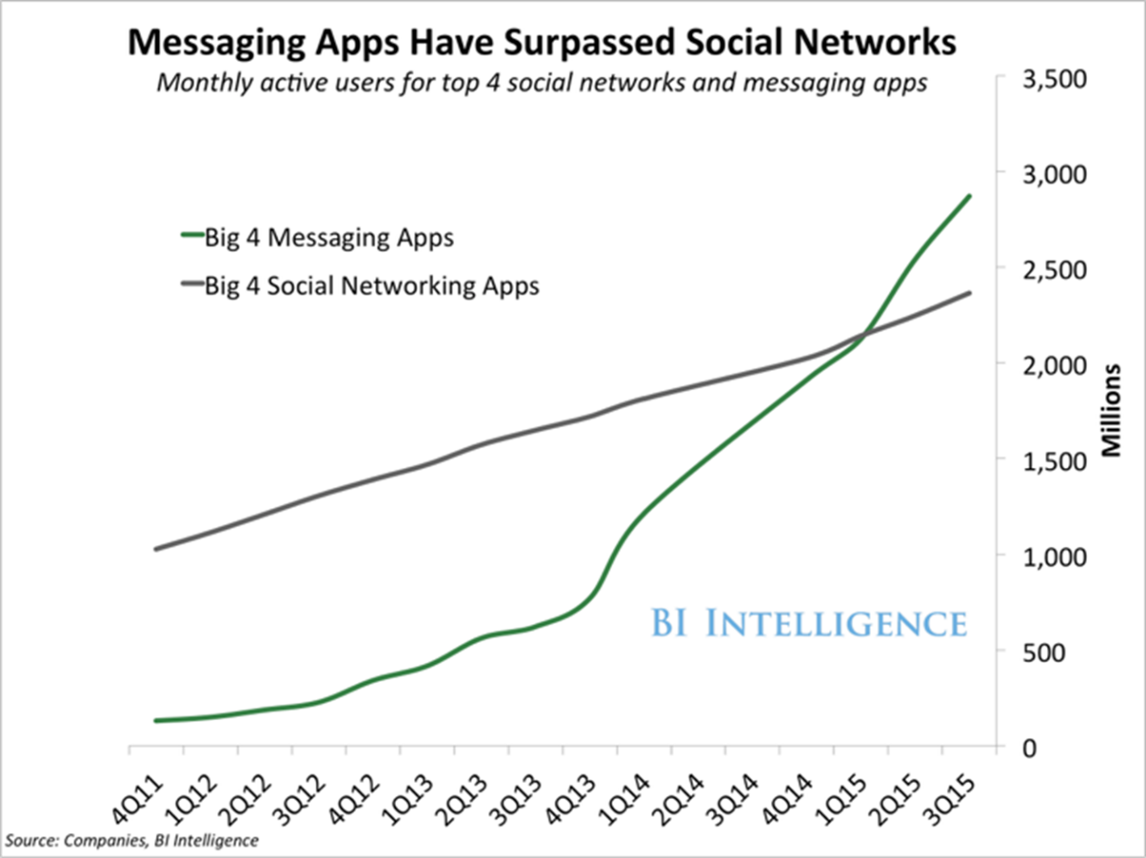
Why Bots, Why Now?
App fatigue
Mobile apps are difficult to build, distribute and maintain
App marketplaces are incredibly crowded
Discovery
Engagement
Versioning
Conversation as the interface
Raise of Artificial Intelligence (AI) mainstream adoption

Slide 53
Integration of Live Chat and Virtual Assistant
Millions per day? Billions per day? How many customers prefer chat? A recent interview shows that a Fortune 500 company in the Telecommunications industry reaches an estimated 8 million website visits per month. Based on recent chat log statistics, a similar company handled upwards of 7,500 Live Chat conversations in one month, for one product line. The truth is your audience prefers the web, and these visitors expect chat as an option.
Leading brands have found a way to shorten the path to a meaningful chat by complementing Live Chat with a Virtual Assistant.

